Slide 2
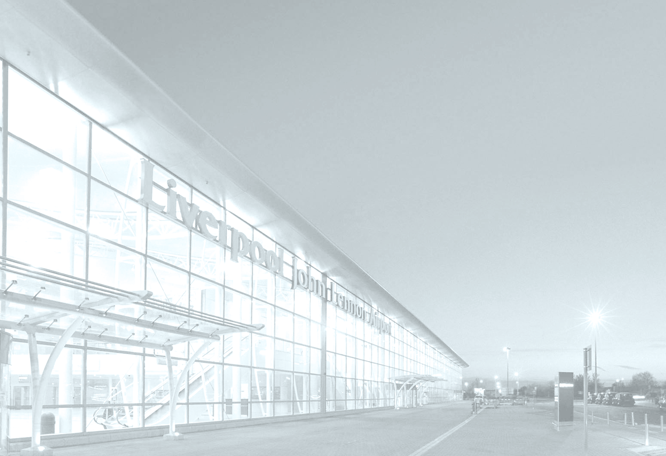
Knowsley Ambassadors Meeting 22 May 2015 Andrew Cornish – CEO

Slide 3
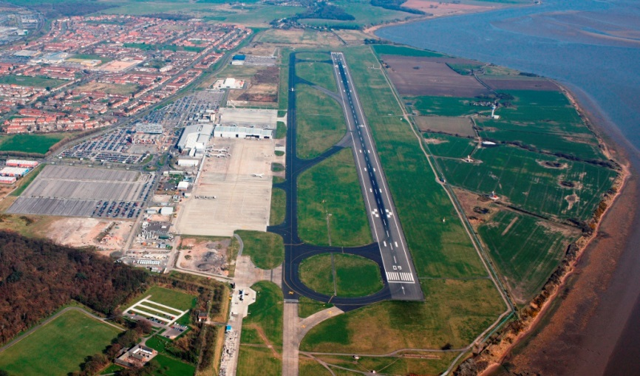
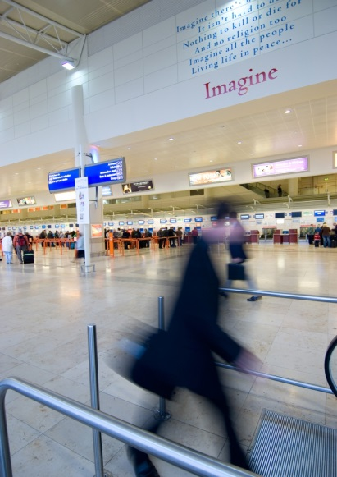
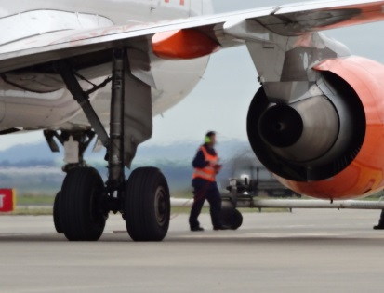
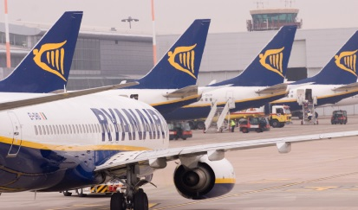
Liverpool is a key economic driver for the Region
Supports 4,750 FTE jobs
£300m contribution to the City Region
Generates £175m GVA
£134m spend in the visitor economy
500,000 visitor arrivals

Slide 4
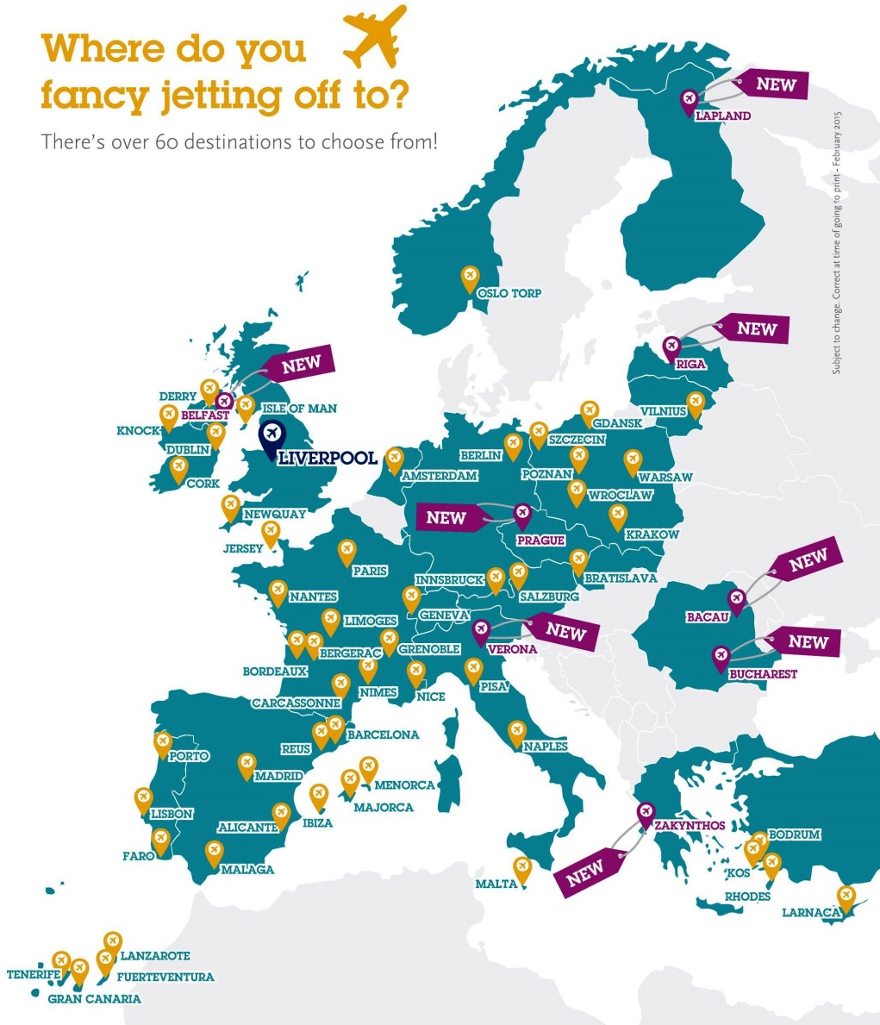
2015 Route Network
4.1m passengers in 2014
25% of passengers are visitors to the region
10% are travelling for business
Connected to over 60 destinations with six airlines

Slide 6
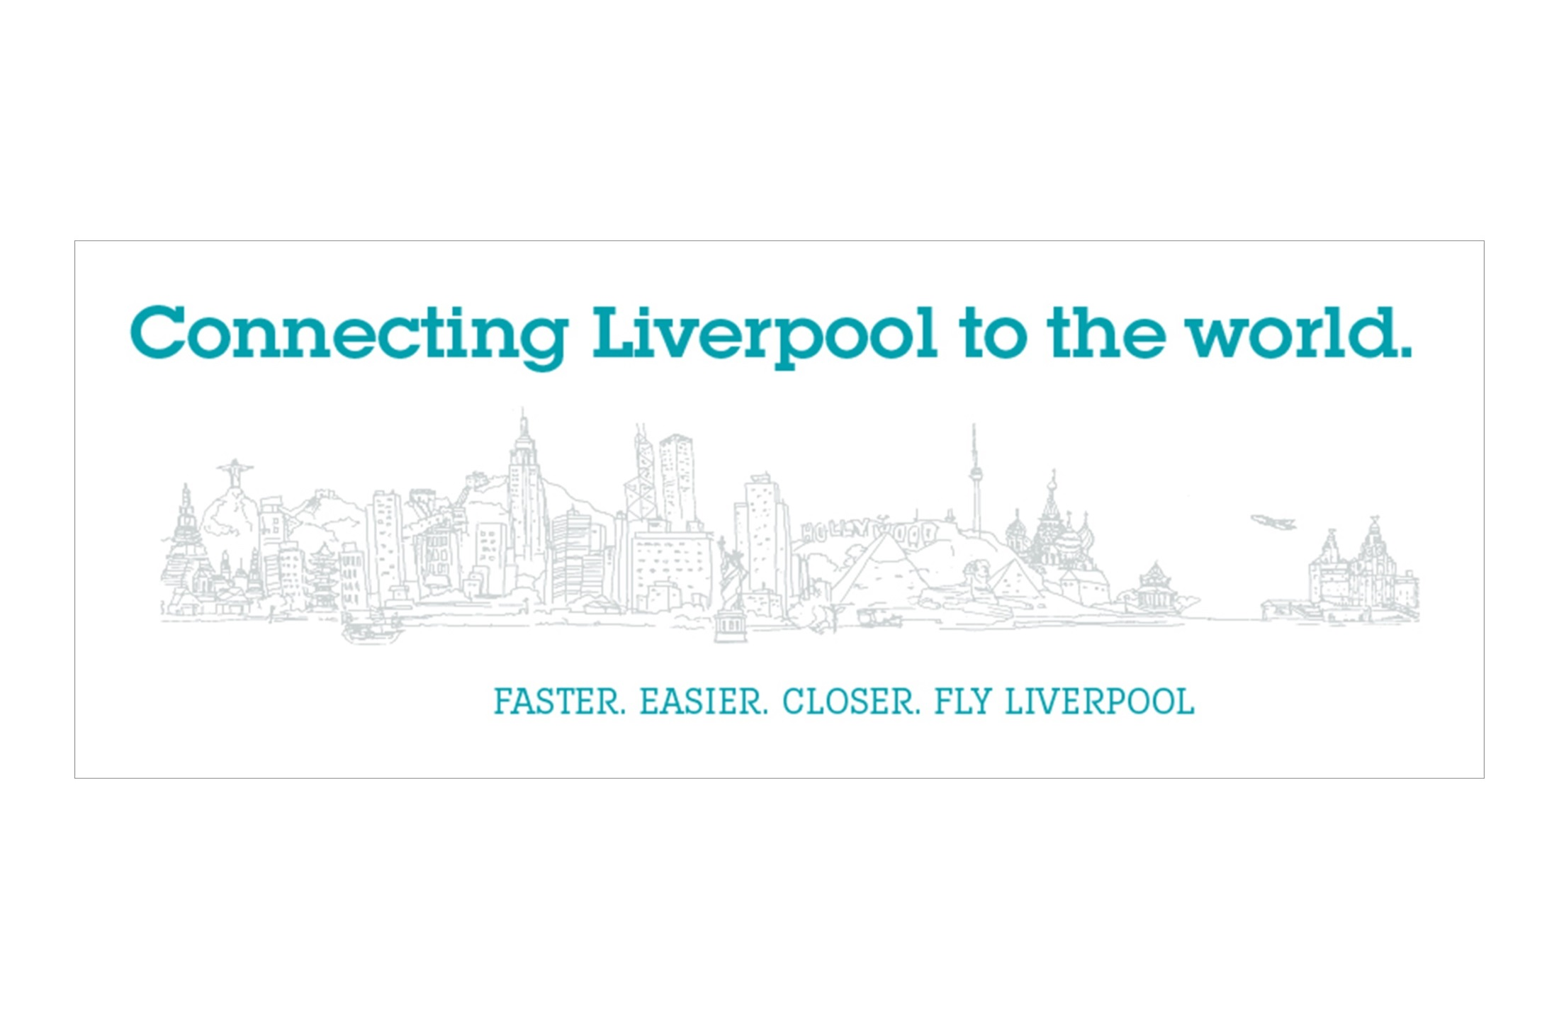

Slide 7
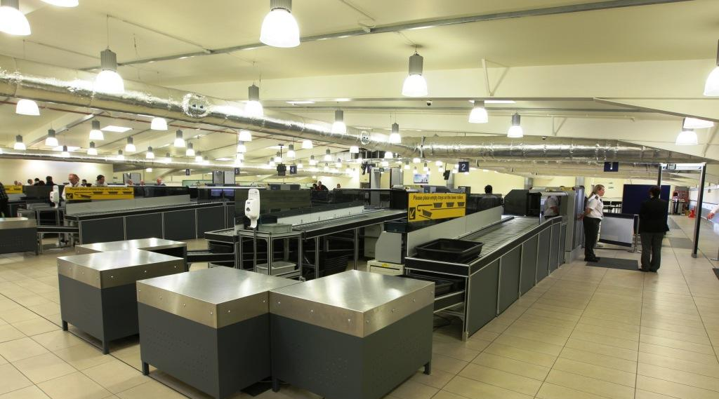
Delivering A ‘Best In Class’ Passenger Experience
Security processing times further reduced to an average of just 7 minutes

Slide 8
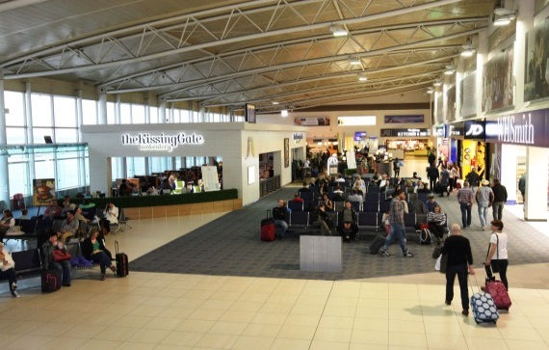
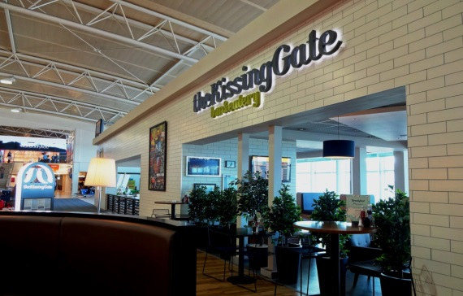
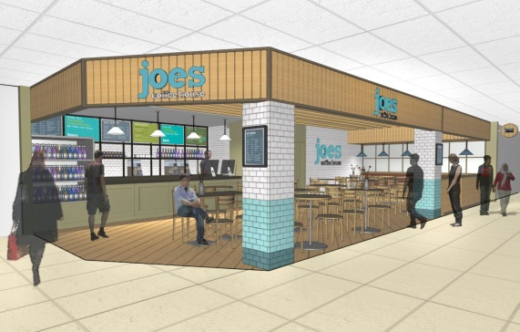
Starting the improvement process
£1m terminal improvements nearing completion
Expanded Kissing Gate bar and eatery
Opened up views across the apron and beyond
Arrival of Joes Coffee House
Expansion to Frankie and Benny’s

Slide 9
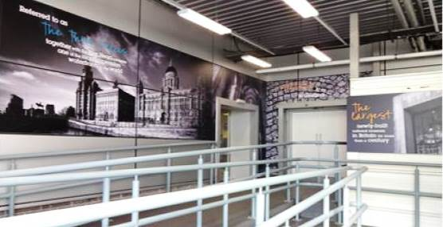
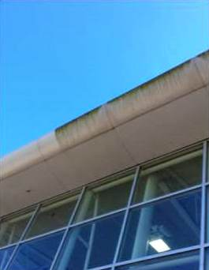
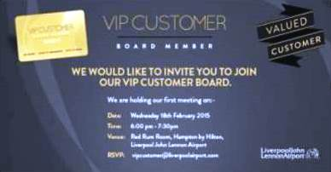
Starting the improvement process
Quick fixes in international arrivals
External terminal cleaning
Re-upholstered seating, replacing ’08 logos
VIP Customer Board
listening to feedback and insight into customers

Slide 10
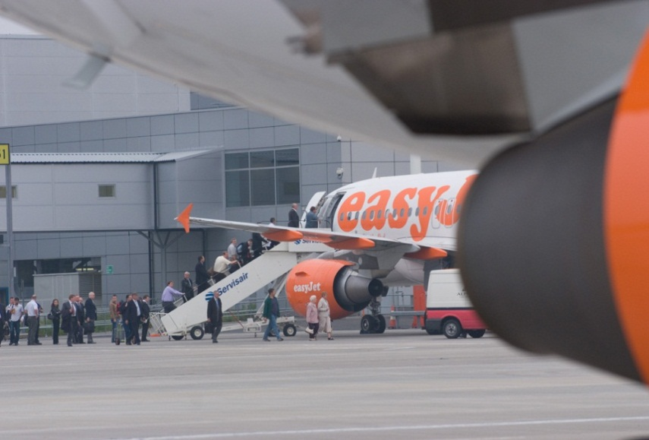
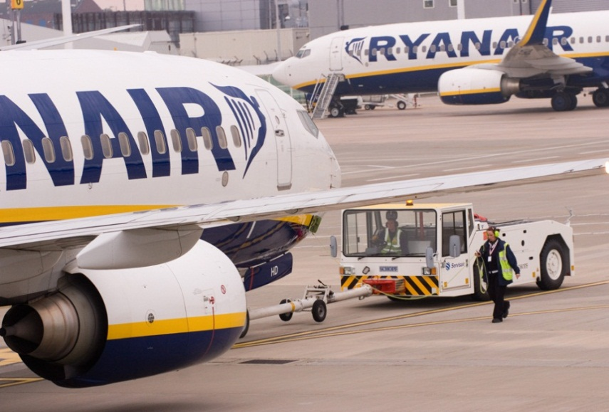
One of the UK’s best airports for on time performance
In 2014, of 10 UK reporting airports, 79% of flights departed within 15 mins of schedule
At LJLA the figure was 90%, at MAN this was 76%

Slide 11
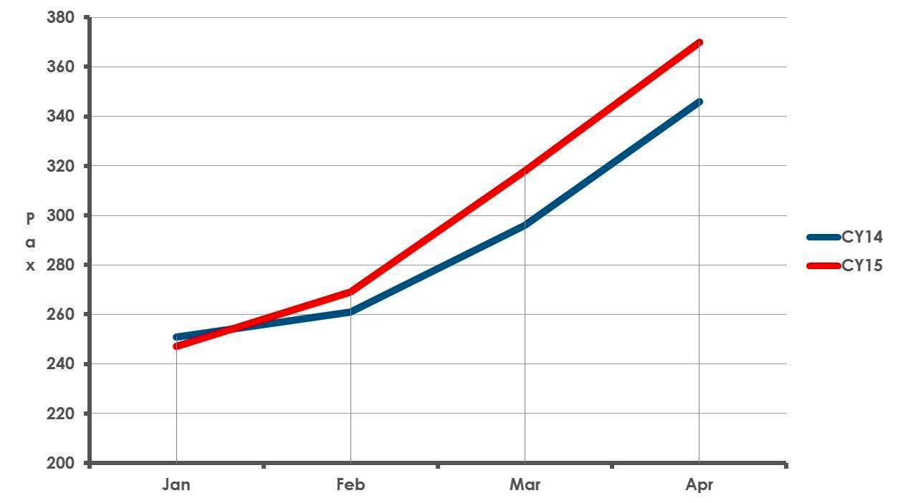
A strong start to 2015
Monthly passenger numbers
Passenger numbers have continued to rise:
February +3.5%,
March +8%
April +5%
Growth driven by new capacity and improved Ryanair performance

Slide 13
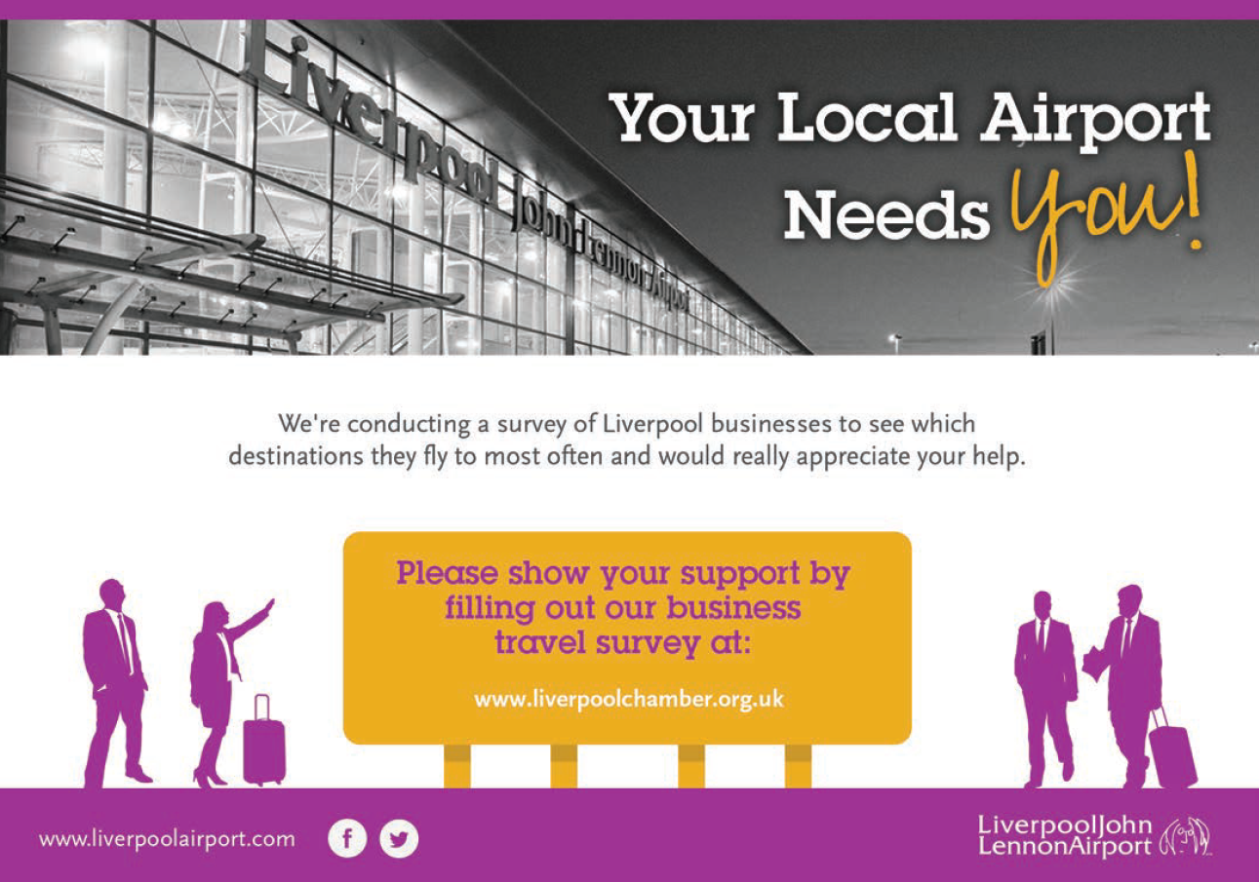
Understanding the Region’s travel habits
www.liverpoolairport.com/travelsurvey

Slide 15
LIVERPOOL CITY REGION VISITOR ECONOMY
22nd May 2015
Knowsley Ambassadors

Slide 16
The role of the LEP
A Destination Management Organisation for the LCR and its stakeholders
Promoting the destination to potential visitors.
Ensuring the destination offer meets expectations & delivers an outstanding visitor experience.
Leading sector development through intelligence, vision and strategy & monitoring sector performance.

Slide 17
Current worth of the Visitor Economy to the Liverpool City Region
Latest Performance Figures:
Annual Visitor Spend (2013) – £3.64bn
Supporting 48,600 jobs
Day visitors – 58m
Liverpool in 2013 was the 5th most popular destination for international visitors
Knowsley, Halton & St Helens account for £4.4 million of spend, 6,000 jobs & 9 million visitors (day & staying).

Slide 18
Where Visitors Come From (2014)
Top overseas markets: Top domestic markets:
Ireland 4% London & Southeast 26%
USA 3% Yorkshire 18%
Spain 3% Northeast 8%
Germany 2% Wales 7%
Australia 3% Cheshire 6%
France 3% Scotland 6%
Source: Liverpool Destination Survey 2014
Notes:
Visitors from Australia have increased to the UK, potentially due to favourable exchange rates etc.
Emerging markets – Brazil, Russia, India and China – growing wealth and interest in European culture

Slide 19
Supporting the LCR Growth Plan
Strategy to 2025:
International Conference Markets & Exhibitions.
Staycations – Culture & Heritage Visitors.
International Leisure Visitors.
Digital Connectivity.
Transport Connectivity.
Welcome & Skills.
Brand Distinctiveness.
Targets for 2025:
Additional £652 million/12K FTE jobs by 2020.
Additional £1.2 billion in spend and 22K FTE jobs by 2025.
Notes:
Consultation – Visit England, Local Authority VE Officers and LCR VE Stakeholders.
Comparators - Working to these growth projections, investment per head of population across the City Region will be equal to that of Greater Manchester by 2020.
LCR Product Positioning - culture, heritage, events/sport and a place to do business.

Slide 20
The importance of Liverpool…
An international brand – Legacy of ’08 international heritage and cultural offer.
Increases reach - Rated 3 on Rough Guide’s Top 10 Cities in the world for 2014 – the only English city on the list.
Infrastructure investment over the last 10 years – Liverpool 1, Culture, hotels, conference/exhibition facilities
Day and staying visitors - valued at £2.4bn/33 million.
Notes:
Reaches the parts our local destinations can’t

Slide 21
Visitor Spread - Attract & Disperse
The attract brands are well - known destinations and icons that consumers in our domestic & international markets recognise.
They serve as starting point in marketing activity to raise interest in discovering the hidden gems.
Dispersal can be geographic or thematic.
Notes:
Visitors don’t recognise our district boundaries!
Districts and attractions outside Liverpool understand near markets and how to reach them.
Why is it important? To capitalise on domestic and international visitors coming to Liverpool - Increase yield/share of spend, increase length of stay, encourage repeat visits.
What does it mean – Integrated marketing, excellent transport connections (to & around the LCR), quality of welcome, packaging and quality of experience.

Slide 22
Playing to our strengths
VisitBritain Research
Low recognition of NW among holiday visitors for rural/coastal locations, activities & attractions, heritage & cultural attractions.
A market opportunity for the City Region’ s other gems…..?
England’s Golf Coast
Regional Meetings, Functions & Conference offer
Heritage & Attractions
Coast & Countryside

Slide 23
Market Trends
Demographics – Aging population, protecting & prioritising expenditure on leisure, tourism & recreation
More discerning customers – ‘cash-tight, time-poor’
Pre trip research – 150 million trip adviser users each month, 115 new reviews every minute!
Inbound Volume – 620K visitor to LCR per annum, 90% staying in Liverpool
Inbound motivations – built heritage, cultural heritage, contemporary culture, sport & shopping
Domestic – Staycation market is thieving, city & urban destinations are driving growth, short breaks are getting shorter
Notes:
Baby boomers are at the time in their lives when they are about to retire - they are affluent and the sector is set to grow in size.
Discerning customers – demand value for money, those venues investing in the experience are benefiting as customer are far less likely to give an experience a second chance.
Inbound motivations – built heritage, cultural heritage, contemporary culture, sport & shopping
Leisure spend – Short breaks, eating & visiting attractions are a normal part of life.
Domestic short breaks in some instances are for only 1 night – Manchester as an example has very short length of stay with visitors motivated by shopping, football and nightlife.

Slide 24
Opportunities for Knowsley
Invest in key assets/themes – Knowsley Safari Park, National Wild Flower Centre, Knowsley Hall, Shakespeare?
Customer focus - Joint packaging and itineraries with other attractions – geographic/thematic
Visibility & familiarisation – thematic marketing, press and PR, visitliverpool and convention bureau
Ease of access – transport connectivity, journey planning, booking etc
Place – Welcome and Upsell
Intelligence & Research – Value of tourism for Knowsley

Slide 25
Structures & Governance
Liverpool City Region Visitor Economy Board
LCR VE Strategy
TAG
LEP DMO
Wirral
Sefton/ Southport
Liverpool
Knowsley
St Helens & Halton
Knowsley Place Strategy

Slide 26
What is the LEP DMO doing?
Marketing – Liverpool City Region marketing strategy to structure markets, experiences, themes and product positioning
Transport – Visitor Economy/Transport Plan for Growth
Welcome & Skills – Skills for Growth Strategy, being delivered with FE colleges
Funding – EU, VisitEngland & DCLG
Intelligence – STEAM, City Region Visitor Survey

Slide 27
Useful Websites
For more information visit:
www.liverpoollep.org
www.visitliverpool.com
www.visitliverpool.biz

Slide 28
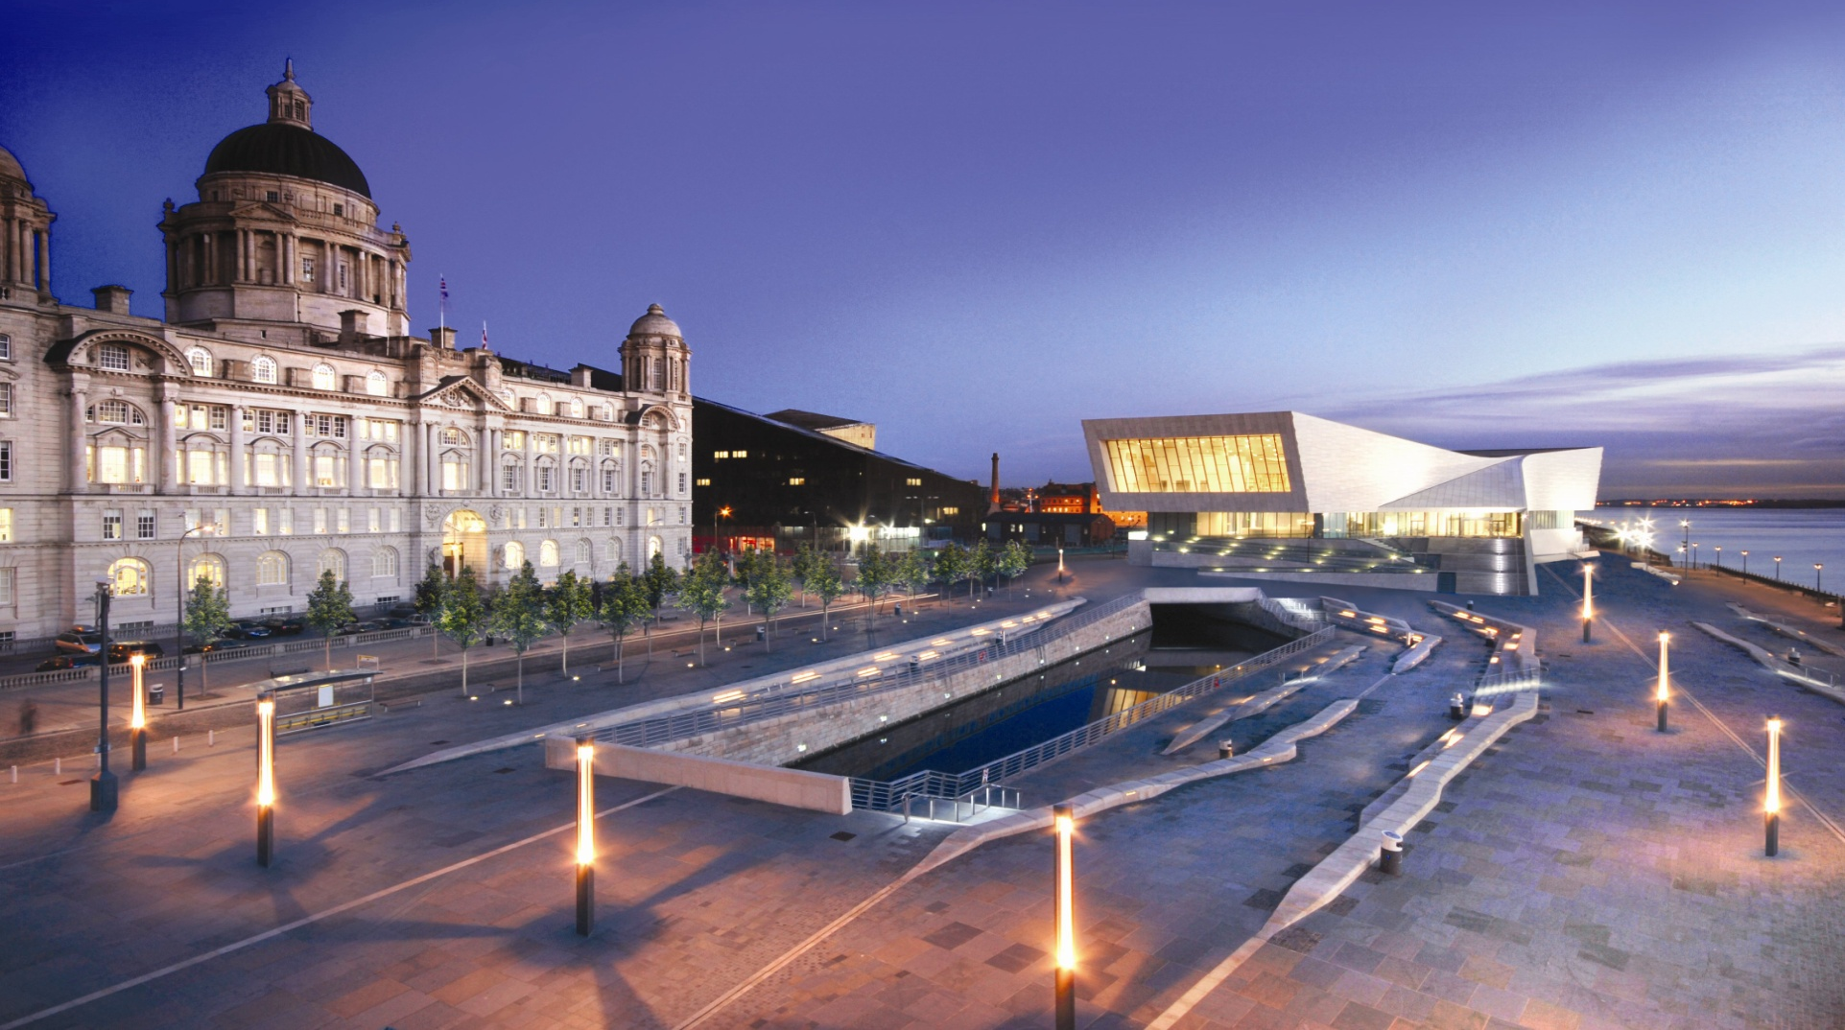
Any Questions?

